Slide 1

MP Neuron & Perceptron

Slide 2

MP Neuron & Perceptron
Courtesy :: NPTel lecture series from IIT Madras – Mitesh Kapra,
Coursera : Andrew NG, Deep Learning
fast.ai, Dive into Deep Learning

Slide 3
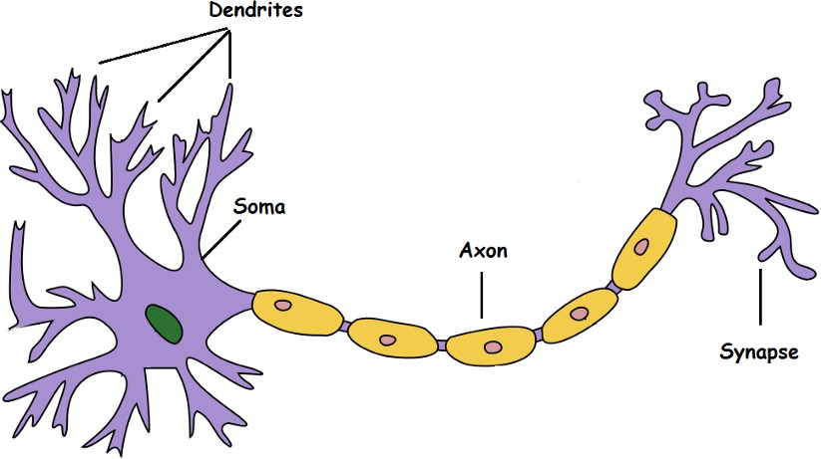
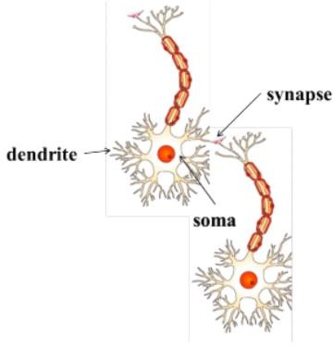
Takes an input, processes it, throws out an output.
Dendrite: Receives signals from other neurons
Soma: Processes the information
Axon: Transmits the output of this neuron
Synapse: Point of connection to other neurons
Biological Neuron
Courtesy: Towardsdatascience.com

Slide 4
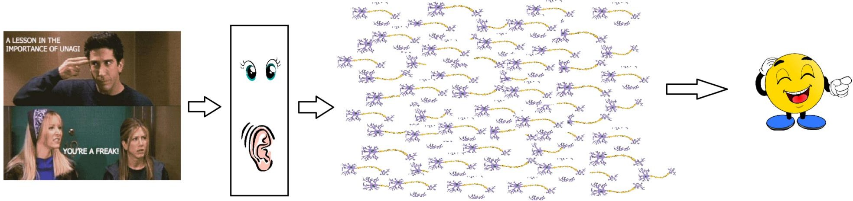
Biological Neuron
Our sense organs interact with the outer world and send the visual and sound information to the neurons
Each neuron gets fired/activated only when its respective criteria is met
. Let's say you are watching a video clip. Now the information your brain receives is taken in by the “laugh or not” set of neurons that will help you make a decision on whether to laugh or not.
There is a massively parallel interconnected network of 10¹¹ neurons (100 billion) in our brain and their connections are not simple
Courtesy: Towardsdatascience.com

Slide 5
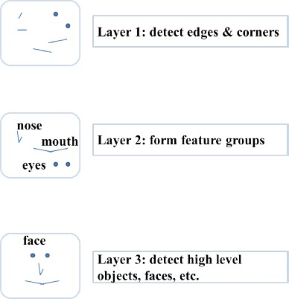
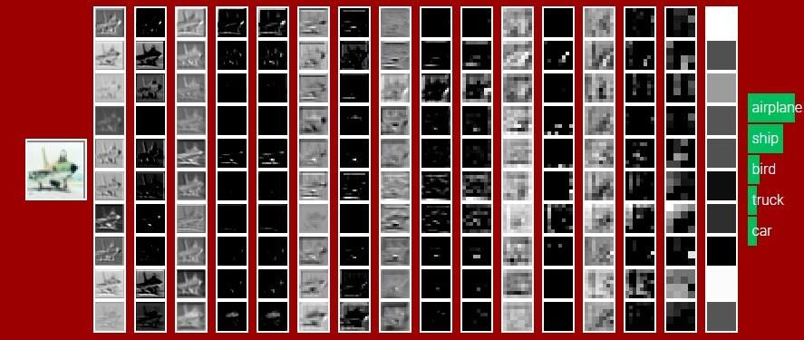
Neurons are arranged in a hierarchical fashion
Neurons are arranged in a hierarchical fashion and each layer has its own role and responsibility.
To detect a face, the brain could be relying on the entire network
and not on a single layer.
Courtesy :Sample illustration of hierarchical
processing. Credits: Mitesh M. Khapra’s lecture slides

Slide 6
The very first step towards the perceptron we use today was taken in 1943 by McCulloch and Pitts, by mimicking the functionality of a biological neuron.

Slide 7
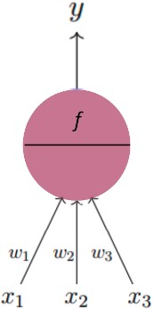
Artificial Neuron
The fundamental Building block of Deep Learning
The fundamental unit of deep neural networks is is called an artificial neuron/perceptron
g
Courtesy :: Mitesh M. Khapra’s lecture slides

Slide 8
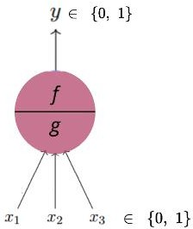
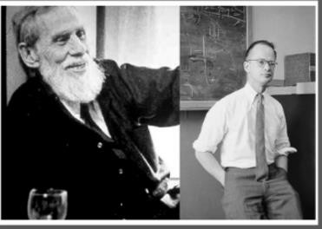
Artificial Neuron
“threshold logic” to mimic the thought process
The fundamental Building block of Deep Learning
McCulloch-Pitts Neuron
The first computational model of a neuron was proposed by
Artificial Neural Networks
Warren MuCulloch (neuroscientist) and Walter Pitts (logician) in 1943
It may be divided into 2 parts. The first part, g takes an input (ahem dendrite ahem), performs an aggregation and based on the aggregated value the second part, f makes a decision.
Lets suppose that I want to predict my own decision, whether to watch a random football game or not on TV?.
The inputs are all boolean i.e., {0,1} and my output variable is also boolean {0:
Will watch it, 1: Won’t watch it}.
So, x_1 could be isPremierLeagueOn (I like Premier League more)
x_2 could be isItAFriendlyGame (I tend to care less about the friendlies)
x_3 could be isNotHome (Can’t watch it when I’m running errands. Can I?)
x_4 could be isManUnitedPlaying (I am a big Man United fan. GGMU!) and so
on.

Slide 9
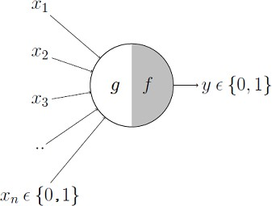
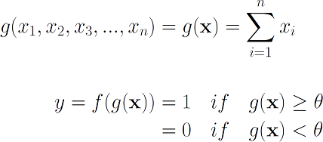
Excitatory or inhibitory inputs.
These inputs can either be excitatory or inhibitory.
Inhibitory inputs are those that have maximum effect on the
decision making irrespective of other inputs
i.e., if x_3 is 1 (not home) then my output will always be 0 i.e., the neuron will never fire, so x_3 is an inhibitory input
Excitatory inputs are NOT the ones that will make the neuron fire on their own but they might fire it when combined together

Slide 10

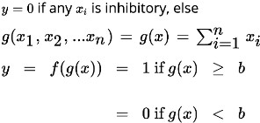
The mathematical Model- McCulloch-Pitts Neuron (MP Neuron)
These inputs can either be excitatory or inhibitory

Slide 11
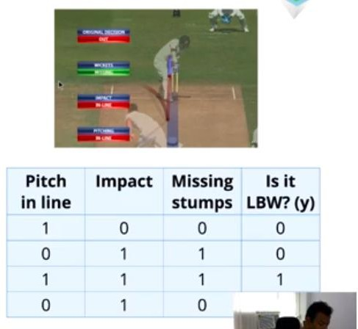
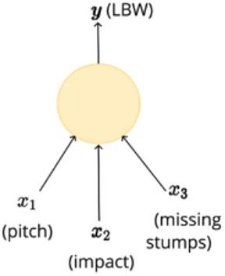
What task can be done with MP Neuron
Courtesy :: Mitesh M. Khapra’s lecture slides

Slide 12
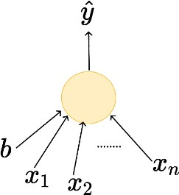
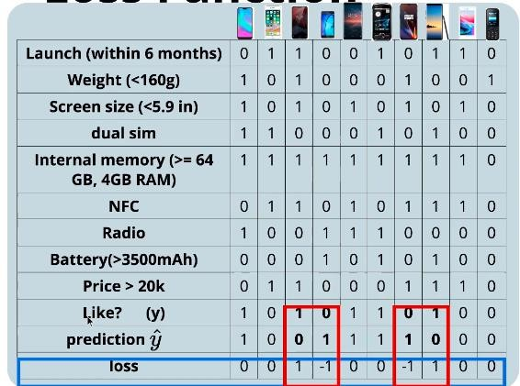




We aim at minimizing the loss function
Loss Function
Courtesy :: Mitesh M. Khapra’s lecture slides

Slide 13
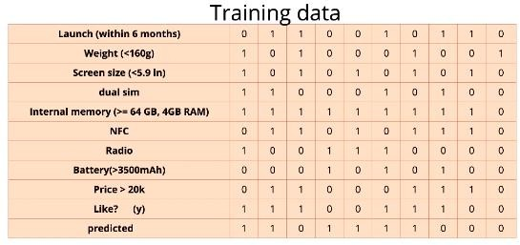
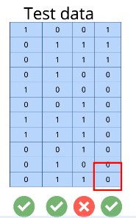


Learning
MODEL
Predictions

Slide 14
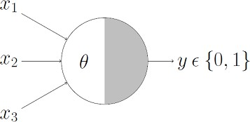
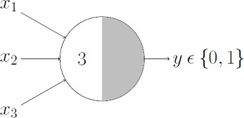
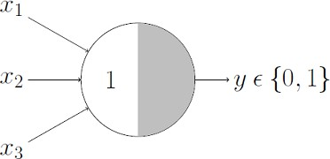
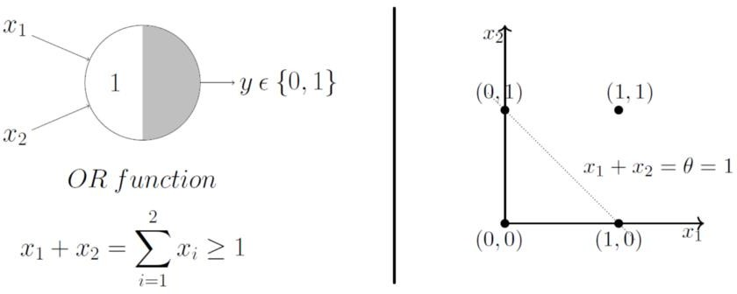
Boolean Functions Using M-P Neuron
OR Function
AND Function
sum ≥ theta, the neuron will fire
otherwise, it won’t.
An AND function neuron would only fire when ALL the inputs are ON
neuron would fire if ANY of the inputs is ON i.e., g(x) ≥ 1 here.
i.e., g(x) ≥ 3 here.
Geometric Interpretation OR function
x_1 + x_2 =1 to graphically show that all those inputs whose output when passed through the OR function M-P neuron lie ON or ABOVE that line and all the input points that lie BELOW that line are going to output 0.
The M-P neuron just learnt a linear decision boundary!

Slide 15
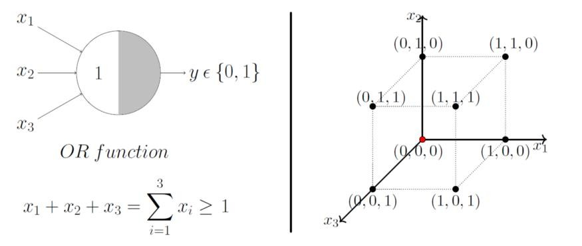
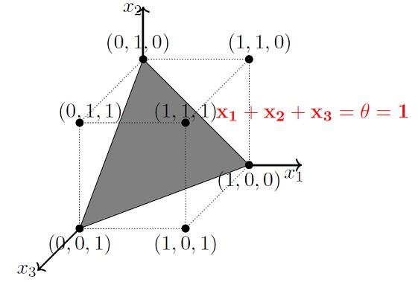
OR Function With 3 Inputs
The plane that satisfies the decision boundary equation x_1 + x_2 + x_3 = 1 is shown below:
Lets just generalize this by looking at a 3 input OR function M-P unit. In this case, the possible inputs are 8 points — (0,0,0),
(0,0,1), (0,1,0), (1,0,0), (1,0,1),… you got the point(s). We can map these on a 3D graph and this time we draw a decision boundary in 3 dimensions.

Slide 16
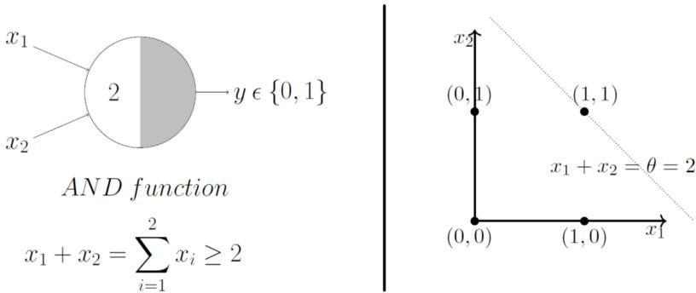
Boolean Functions Using M-P Neuron
AND Function
In this case, the decision boundary equation is x_1 + x_2 =2. Here, all the input points that lie ON or ABOVE, just (1,1), output 1 when passed through the AND function M-P neuron. It fits! The decision boundary works!

Slide 17
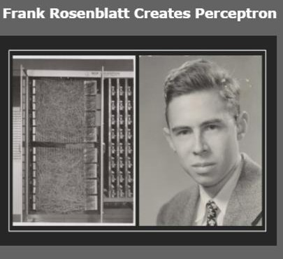
Limitations Of M-P Neuron
What about non-boolean (say, real) inputs?
Do we always need to hand code the threshold?
Are all inputs equal? What if we want to assign more
importance to some inputs?
Frank Rosenblatt
What about functions which are not linearly separable? Say XOR function.
Overcoming the limitations of the M-P neuron, Frank Rosenblatt, an American psychologist, proposed the classical perception model, the mighty artificial neuron, in 1958. It is more generalized computational model than the McCulloch-Pitts neuron where weights and thresholds can be learnt over time

Slide 18
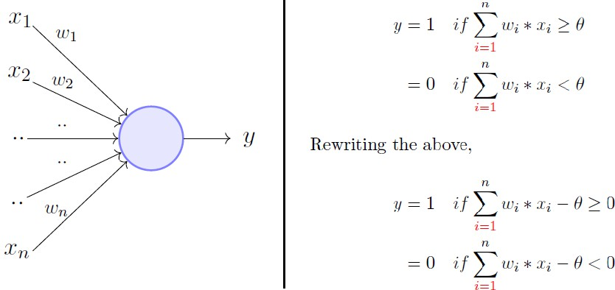
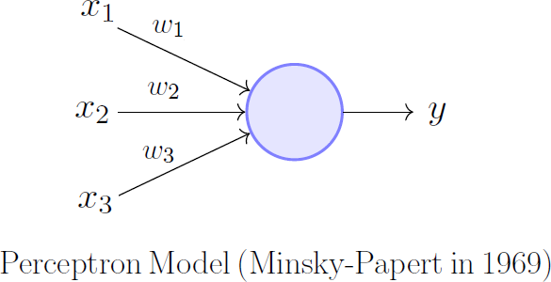
The perceptron model
The perceptron Model:
is very similar to an M-P neuron but we take a weighted sum of the inputs and set the output as one only when the sum is more than an arbitrary threshold (theta).
It overcomes some of the limitations of the M-P neuron by
introducing
the concept of numerical weights (a measure of importance) for inputs,
a mechanism for learning those weights.
Inputs are no longer limited to boolean values like in the case
of an M-P neuron,
it supports real inputs as well which makes it more useful and generalized.
However, according to the convention, instead of hand coding the thresholding parameter theta, we add it as one of the inputs, with the weight -theta like shown in next slide, which makes it learnable

Slide 19
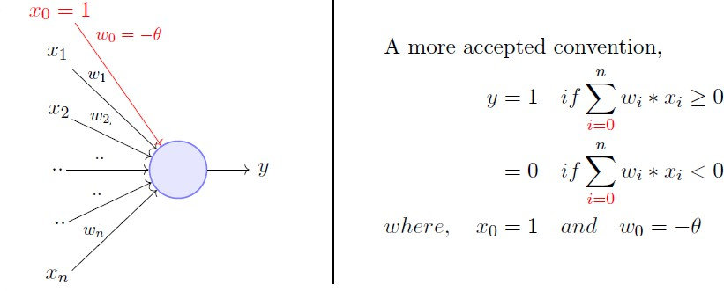
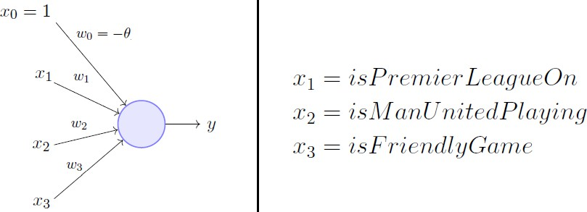
Theta add as one of the inputs- theta(θ) is b i a s
theta, is treated as bias, with the weight -theta like shown above, which makes it learn-able
Here, theta(θ) is called the bias because it represents the prior (prejudice).
A football freak may have a very low threshold and may
watch any football game irrespective of the league, club or
importance of the game [theta = 0].
The weights and the bias will depend on the data (my viewing history in football watching).
On the other hand, a selective viewer may only watch a
football game that is a premier league game, featuring Man United game and is not friendly [theta = 2].

Slide 20
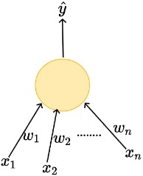
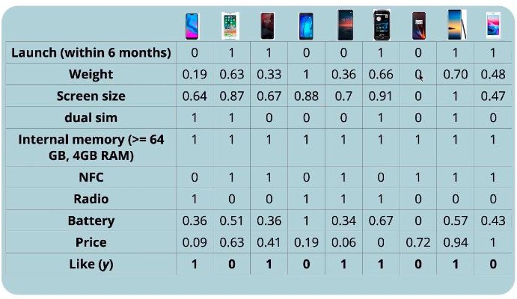

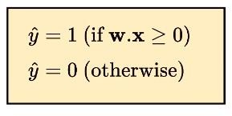
Perceptron- Frank Rosenblatt
W0=b
X0=1
Real Inputs
Boolean outputs
Weight assigned for each input
Linear
Courtesy :: Mitesh M. Khapra’s lecture slides

Slide 21
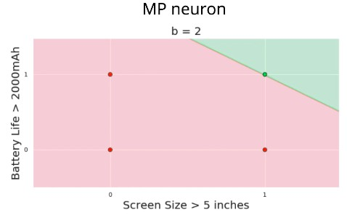
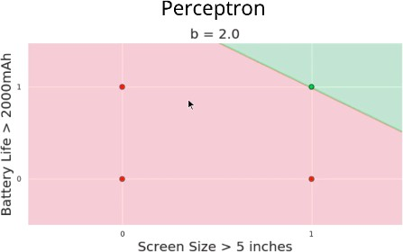




Geometric Interpretation
Flexible Slope
Fixed Slope
Courtesy :: Mitesh M. Khapra’s lecture slides

Slide 22
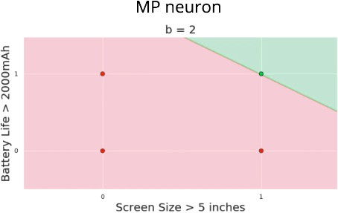
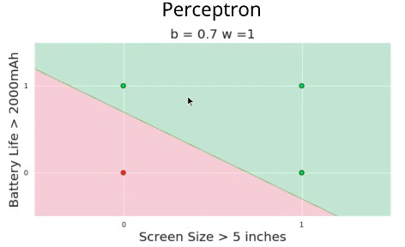
Geometric Interpretation
Flexible Slope
Fixed Slope

Slide 23
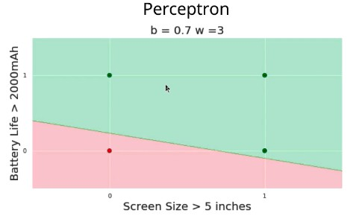


Geometric Interpretation
Flexible Slope
Fixed Slope

Slide 24
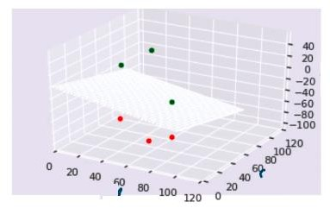
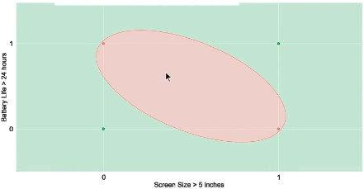
More dimensions

Slide 25
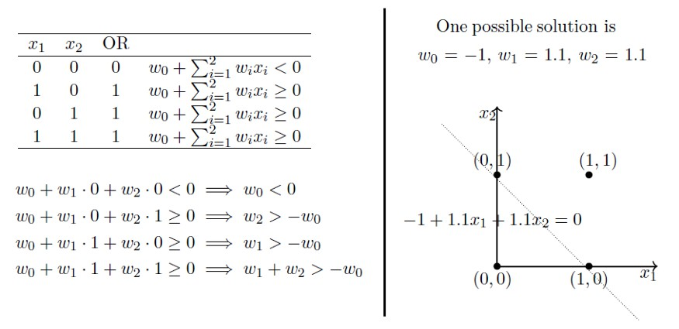
Boolean Functions Using Perceptron
OR Function
The above ‘possible solution’ was obtained by solving the linear system of equations on the left. It is clear that
the solution separates the input space into two spaces, negative and positive half spaces
if you actually try and solve the linear equations above, you will realize that there can be multiple solutions. But which solution is the best? To more formally define the ‘best’ solution, we need to understand errors and error surfaces, - and perceptron learning algorithm

Slide 26
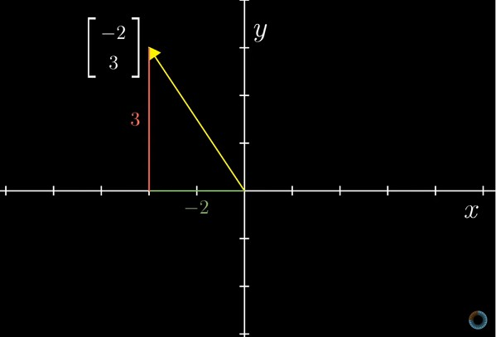
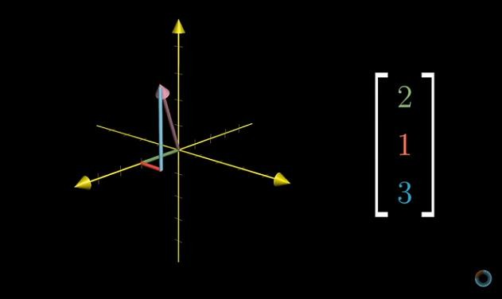
Basics of Linear Algebra- Vector Visualization
Vector Representations
A 2-dimensional vector can be represented on a 2D plane as
follows:
3D Vector Representations
Source: 3Blue1Brown’s video on Vectors

Slide 27
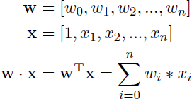
Dot Product of 2 vectors
Dot product :Imagine you have two vectors with size n+1, w and x, the dot product of these vectors (w.x)
could be computed as follows:
Here, w and x are just two lonely arrows in an n+1
dimensional space
Intuitively, their dot product quantifies how much one vector is going in the direction of the other.
So technically, the perceptron was only computing a lame dot
product (before checking if it's greater or lesser than 0).
The decision boundary line which a perceptron gives out that separates positive examples from the negative ones is really just w . x = 0.
The transpose is just to write it in a matrix multiplication form.

Slide 28

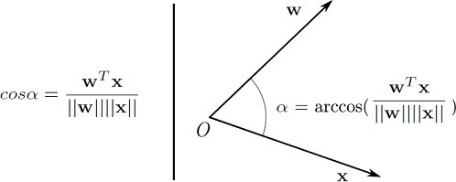
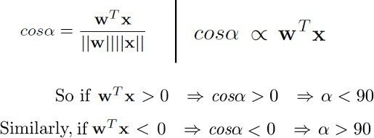
Angle Between Two Vectors
When we say that the cosine of the angle between w and x is 0,
arrow w is being perpendicular to arrow x in an n+1 dimensional space (in 2-dimensional space).
So when the dot product of two vectors is 0, they are
perpendicular to each other.
you can get the angle between two vectors, if only you knew the vectors, given you know how to calculate vector magnitudes and their dot products

Slide 29
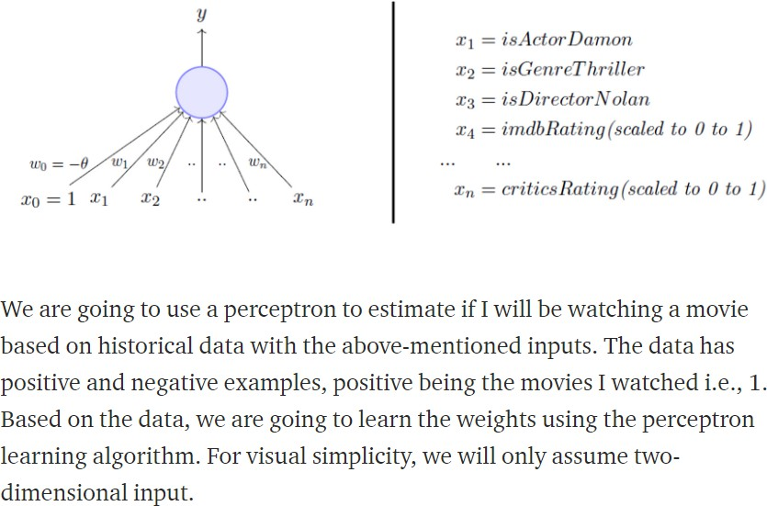
Perceptron Learning Algorithm- setting up the problem

Slide 30

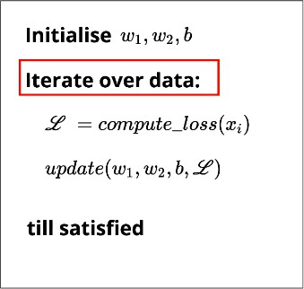
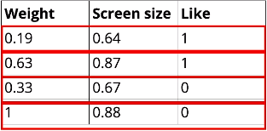
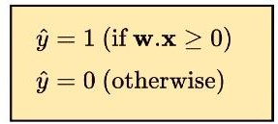
Our goal is to find the w vector that can perfectly classify
positive inputs and negative inputs in our data

Slide 31
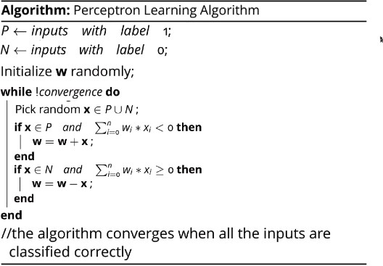

Perceptron Learning Algorithm
P- positive examples N – Negative examples
𝑊₁
𝑊₂
𝑊₃
𝑊₀
𝑥₁
𝑥₂
𝑥₃
𝑏
𝒘 =
𝒙 =

Slide 32
Perceptron Learning Algorithm
𝑊₁
𝑊₂
𝑊₃
𝑊₀
𝑥₁
𝑥₂
𝑥₃
𝑏
𝒘 =
𝒙 =

Slide 33
Perceptron Learning Algorithm
(P U N) both positive and negative examples
𝑊₁
𝑊₂
𝑊₃
𝑊₀
𝑥₁
𝑥₂
𝑥₃
𝑏
𝒘 =
𝒙 =
Case 1: When x belongs to P and its dot product w.x < 0
Case 2: When x belongs to N and its dot product w.x ≥ 0

Slide 34


Intuition behind perceptron learning Algorithm
when x belongs to P, we want w.x > 0, basic perceptron rule. What we also mean by that is when x belongs to P, the angle between w and x should be less than 90 degrees. because the cosine of the angle is proportional to the dot product.
whatever the w vector may be, as long as it makes an angle less than 90 degrees with the positive example data vectors (x E P) and an angle more than 90 degrees with the negative example data vectors (x E N), we are cool. So ideally, it should look something like the figure on left←-:

Slide 35



Intuition behind perceptron learning Algorithm
So when we are adding x to w, which we do when x belongs to P and w.x < 0 (Case 1), we are essentially increasing the cos(alpha) value, which means, we are decreasing the alpha value, the angle between w and x, which is what we desire. And the similar intuition works for the case when x belongs to N and w.x ≥ 0 (Case 2).

Slide 36


Procedures of a Single-layer
Perceptron Network
Step -Activation Function
Courtesy: towardsdatascience.com

Slide 37




Limitations of Perceptron
1D
How about these? Non linearly separable data?
2D

Slide 38

XOR Function — Can’t Do!- Non Linearly separated data
Notice that the fourth equation contradicts the second and the third equation. Point is, there are
no perceptron solutions for non-linearly separated data. So the key take away is that a single perceptron cannot learn to separate the data that are non-linear in nature.

